Slide 1

ECE 1710: Power Distribution Engineering and Smart Grids
Lecture 15
Dr. Robert Kerestes
University of Pittsburgh
Swanson School of Engineering
Department of Electrical and Computer Engineering
Notes:
Instructions for editing school and department titles:
Select from menu: View > Master > Slide Master
Click on each text area you wish to edit. Text will become editable.

Slide 2
Outline
Outline of Lecture No. 15
Module #1: Introduction to Three-Phase Transformers
Module #2: The Delta-Grounded Wye Step-Down Connection
Module #3: Use of Capacitors in Distribution Systems
Module #4: Loads in Distribution Systems

Slide 3
Learning Objectives
Learning Objectives:
Model delta-wye transformers and use these models to perform forward-sweep, backward-sweep power flow analysis
Model capacitors as inputs to a power flow solution
Model constant power loads as inputs to a power flow solution

Slide 4
Introduction to Three-Phase Transformers
Module #1

Slide 5
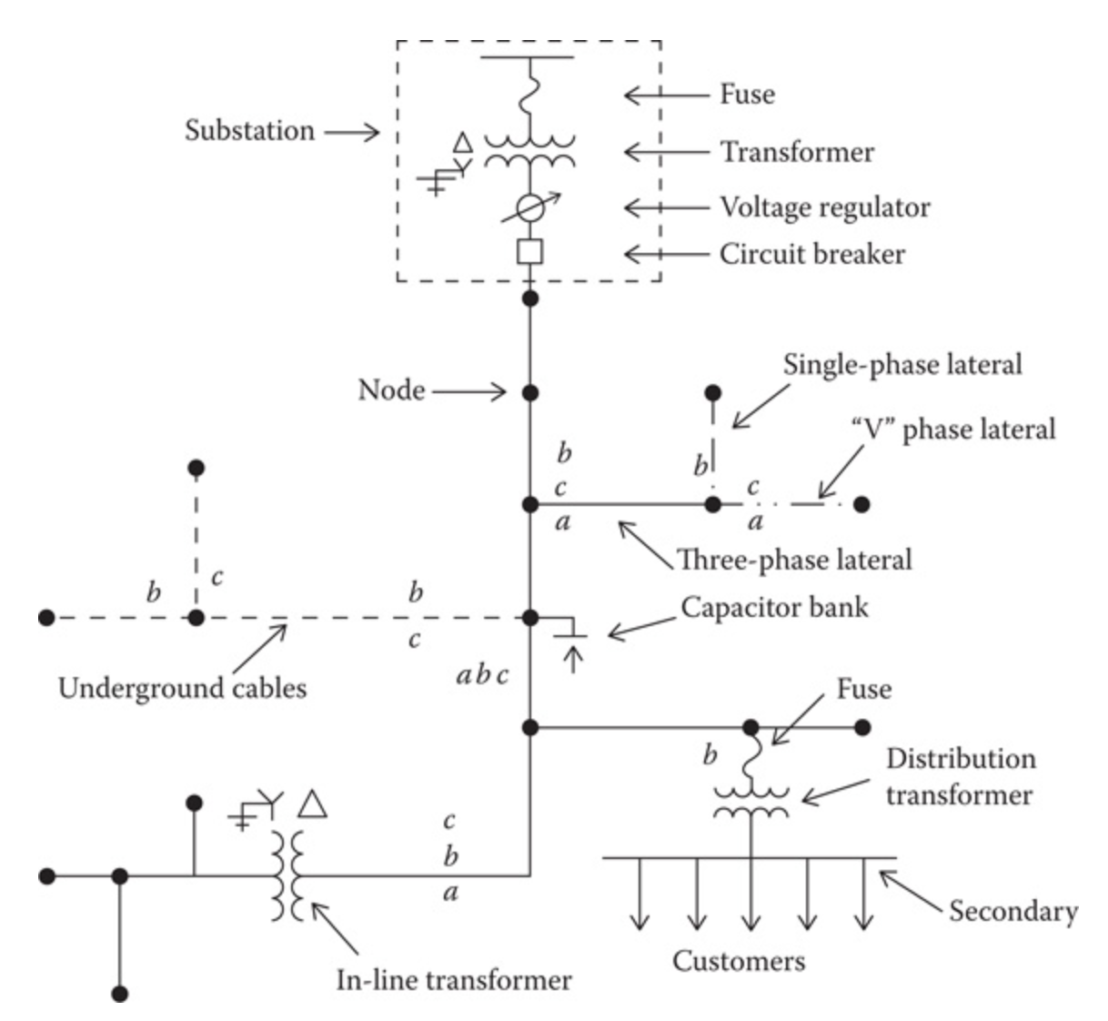
Introduction to Three-Phase Transformers
Module #1
Three-phase transformer banks are found in the distribution substation, where the voltage is transformed from the transmission or subtransmission level to the distribution feeder level.
Substation transformer

Slide 6
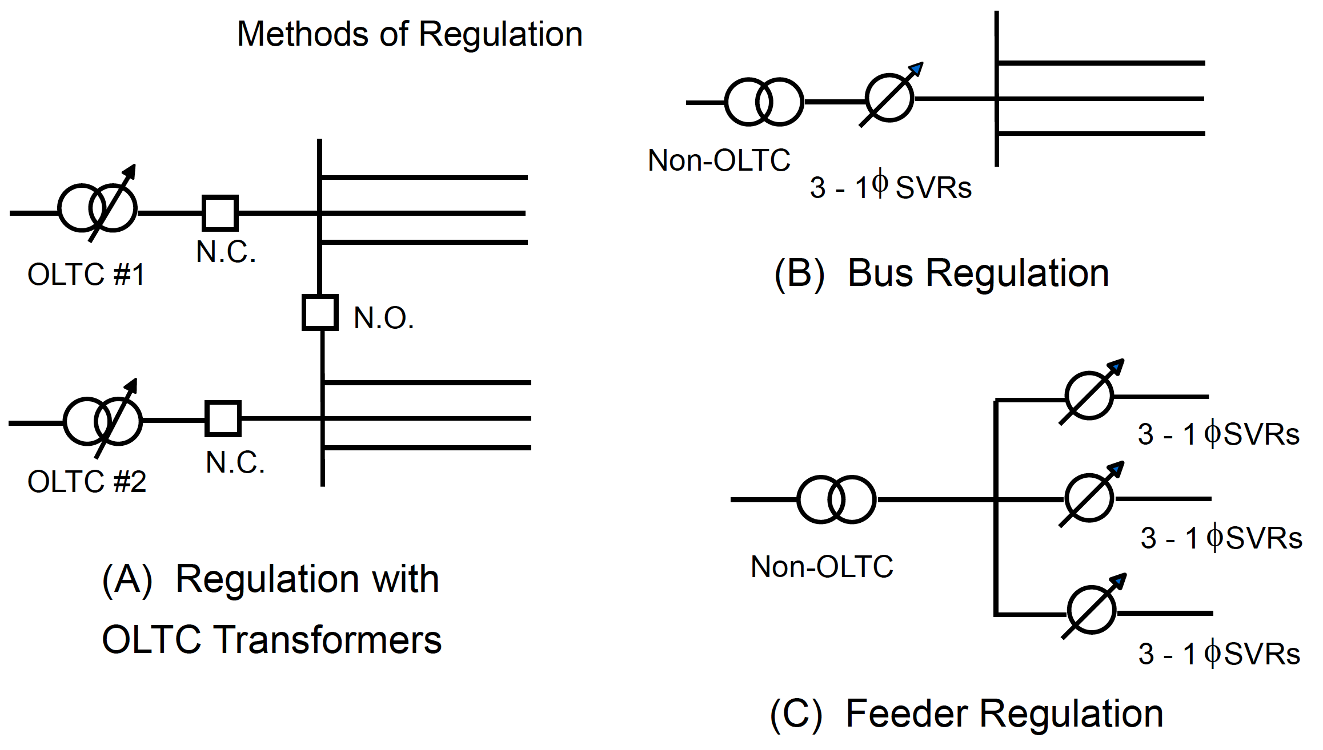
Introduction to Three-Phase Transformers
Module #1
Voltage regulation can be done with or without step regulators

Slide 7
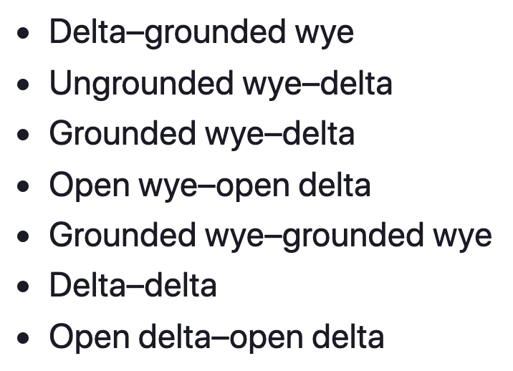
Introduction to Three-Phase Transformers
Module #1
Unique models of three-phase transformer banks applicable to radial distribution feeders exist. Models for the following three-phase connections are included:

Slide 8
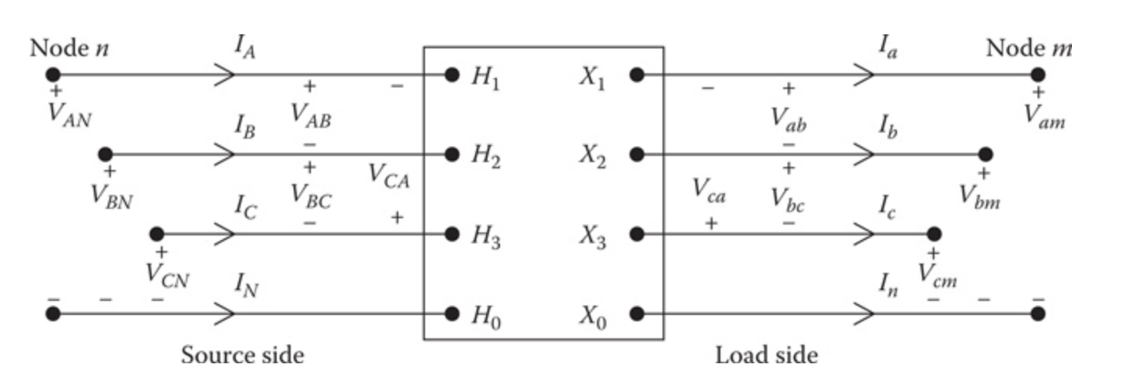
Introduction to Three-Phase Transformers
Module #1
The following figure defines the various voltages and currents for all three-phase transformer banks connected between the source-side node n and the load-side node m.

Slide 9
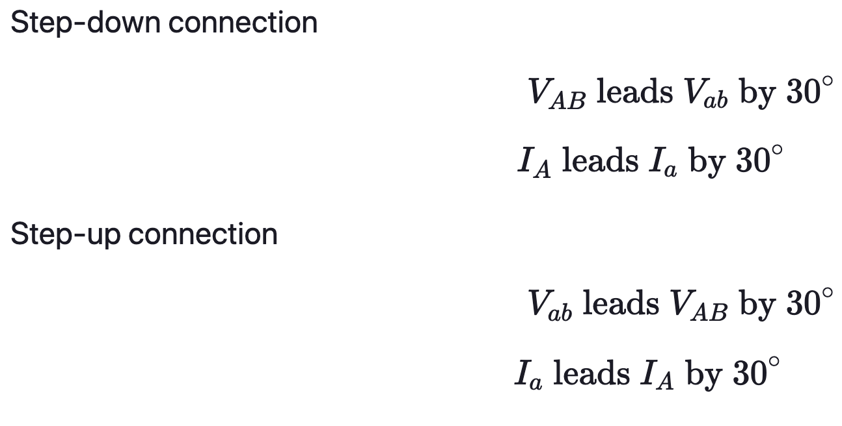
Introduction to Three-Phase Transformers
Module #1
Delta-Wye connected transformer has a 30 degree phase shift associated
It is assumed that all variations of the wye–delta connections are connected in the “American Standard Thirty Degree” connection.
The described phase notation and the standard phase shifts for positive sequence voltages and currents are:

Slide 10
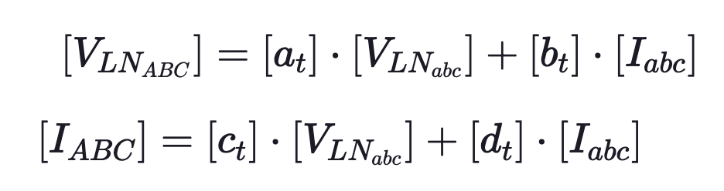
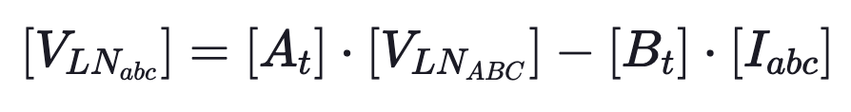
Introduction to Three-Phase Transformers
Module #1
The models to be used in power-flow and short-circuit studies are generalized for the connections in the same form as have been developed for line segments and voltage regulators

Slide 11
The Delta-Grounded Wye Step-Down Connection
Module #2

Slide 12
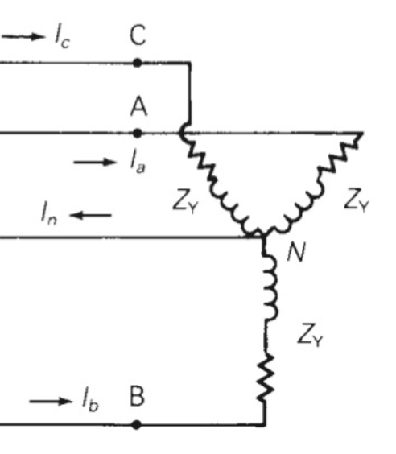
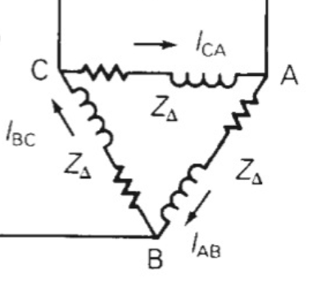
The Delta-Grounded Wye Step-Down Connection
Module #2
A delta-connected circuit and a wye connected circuit are shown below. We can connect transformer windings in the same way:
Delta
Wye

Slide 13
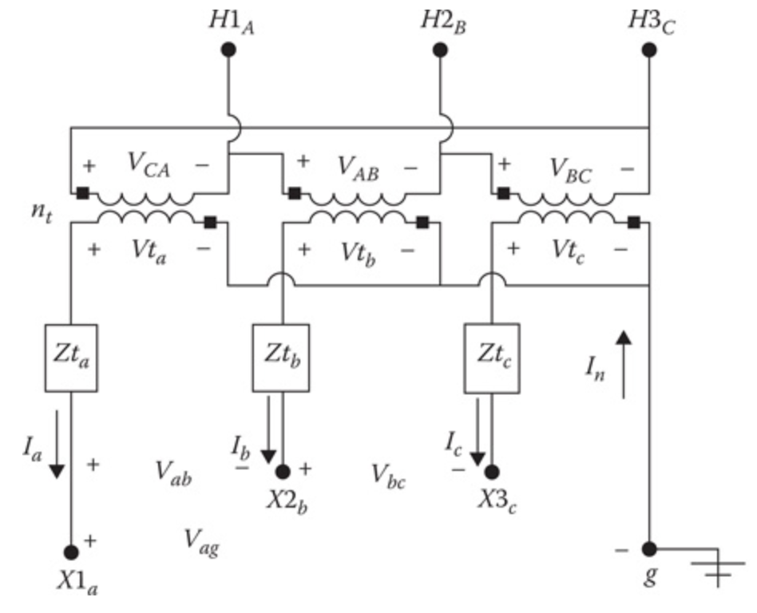
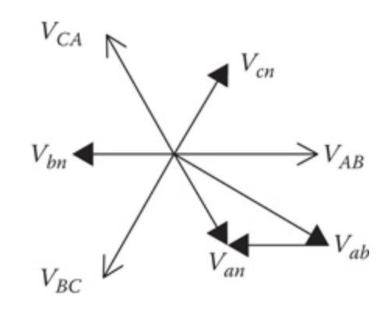
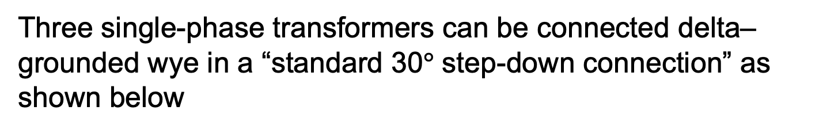
The Delta-Grounded Wye Step-Down Connection
Module #2
Three single-phase transformers can be connected delta–grounded wye in a “standard 30$°$ step-down connection” as shown below
Connection Diagram
Phasor Diagram

Slide 14
The Delta-Grounded Wye Step-Down Connection
Module #2
Three single-phase transformers can be connected delta–grounded wye in a “standard 30$°$ step-down connection” as shown below
Polarity mark

Slide 15
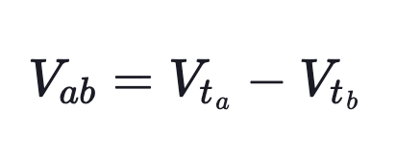
The Delta-Grounded Wye Step-Down Connection
Module #2
Kirchhoff’s Voltage Law at no-load gives the line-to-line voltage between phases a and b as:

Slide 16
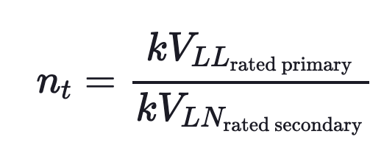
The Delta-Grounded Wye Step-Down Connection
Module #2
The magnitude changes between the voltages can be defined in terms of the actual winding turns ratio (n_{t}). These ratios are defined as follows:

Slide 17
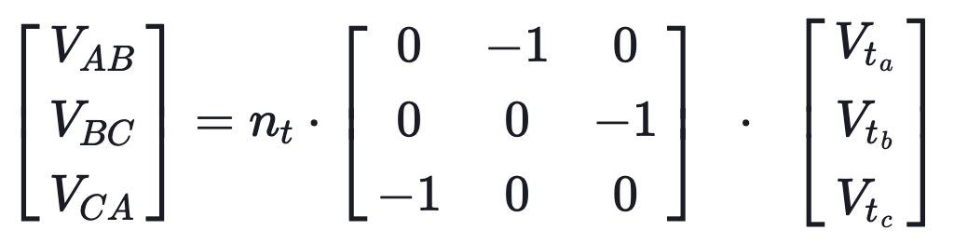

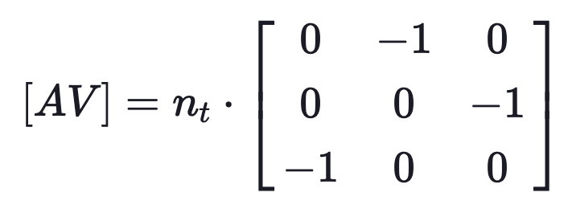
The Delta-Grounded Wye Step-Down Connection
Module #2
The line-to-line voltages on the primary side of the transformer connection as a function of the ideal secondary-side voltages are given by:
where:

Slide 18
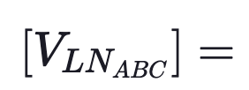
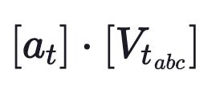
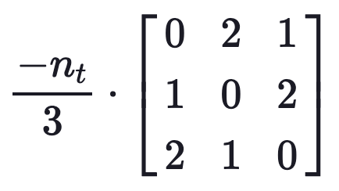
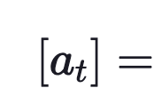
The Delta-Grounded Wye Step-Down Connection
Module #2
Recall that there is no line-to-neutral voltage on a delta connected circuit. However, what is needed is a relationship between “equivalent” line-to-neutral voltages at node n and the ideal secondary voltages.
This is provided in the following equation (derivation is left up to the student)
where:

Slide 19
The Delta-Grounded Wye Step-Down Connection
Module #2
Recall that there is no line-to-neutral voltage on a delta connected circuit. However, what is needed is a relationship between “equivalent” line-to-neutral voltages at node n and the ideal secondary voltages.
This is provided in the following equation (derivation is left up to the student)
where:

Slide 20
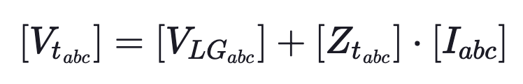
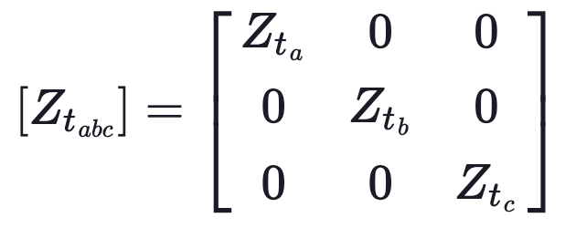
The Delta-Grounded Wye Step-Down Connection
Module #2
The ideal secondary voltages as a function of the secondary line-to-ground voltages and the secondary line currents are:
where

Slide 21


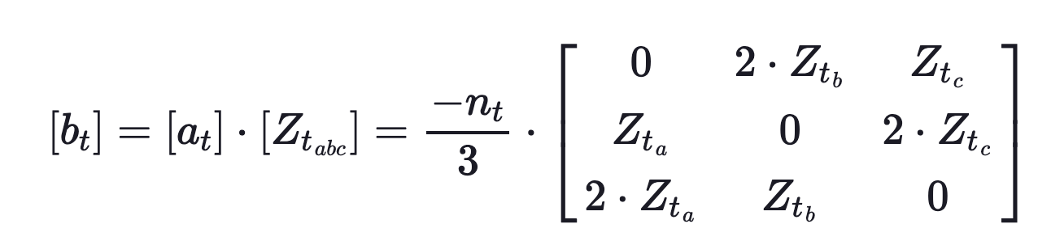
The Delta-Grounded Wye Step-Down Connection
Module #2
Substituting:
where

Slide 22
The Delta-Grounded Wye Step-Down Connection
Module #2
Substituting:
where

Slide 23
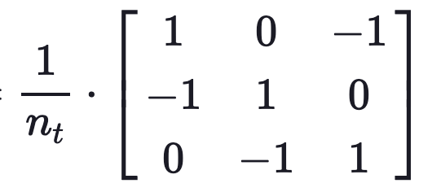
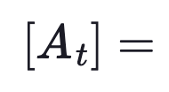
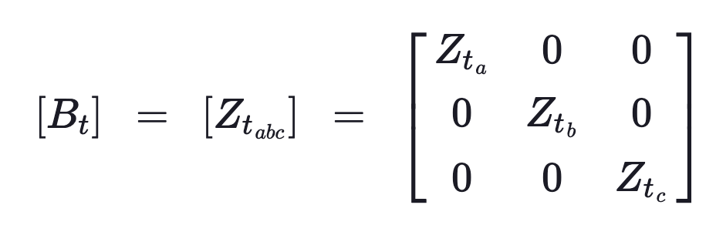

The Delta-Grounded Wye Step-Down Connection
Module #2
The derivation of $\left[A_{t}\right]$, and $\left[B_{t}\right]$ is left up to the student. These matrices are defined by

Slide 24
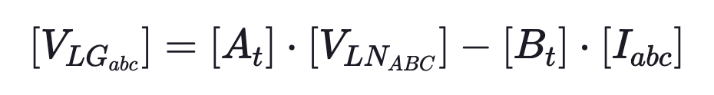

The Delta-Grounded Wye Step-Down Connection
Module #2
With this, we not have the forward sweep
and backward sweep

Slide 25
The Delta-Grounded Wye Step-Down Connection
Module #2
With this, we not have the forward sweep
and backward sweep

Slide 26
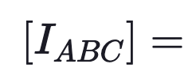
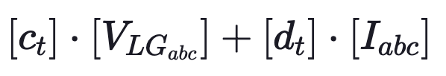
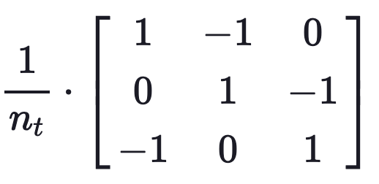
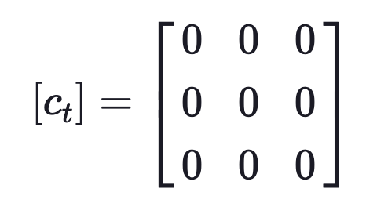

The Delta-Grounded Wye Step-Down Connection
Module #2
The current derivation will be left up to the student, but the resulting backward sweep equation is
where
and

Slide 27
Module #3
Use of Capacitors in Distribution Systems

Slide 28
Use of Capacitors in Distribution Systems
Module #3
Capacitors provide tremendous benefits to distribution system performance. Most noticeably, capacitors reduce losses, free up capacity, and reduce voltage
drop:
Losses; Capacity — By canceling the reactive power to motors and other loads with low power factor, capacitors decrease the line current. Reduced current frees up capacity; the same circuit can serve more load. Reduced current also significantly lowers the I²R line losses.
Voltage drop — Capacitors provide a voltage boost, which cancels part of the drop caused by system loads. Switched capacitors can regulate voltage on a circuit.

Slide 29
Use of Capacitors in Distribution Systems
Module #3
Possible problems caused by capacitors:
If not properly applied or controlled, the reactive power from capacitor banks can create losses and high voltages.
The greatest danger of overvoltages occurs under light load. Good planning helps ensure that capacitors are sited properly.
More sophisticated controllers (like two-way radios with monitoring) reduce the risk of improperly controlling capacitors, compared to simple controllers (like a time clock).

Slide 30
Use of Capacitors in Distribution Systems
Module #3
Capacitors work their magic by storing energy:
Capacitors are simple devices: two metal plates sandwiched around an insulating dielectric.
When charged to a given voltage, opposing charges fill the plates on either side of the dielectric.
The strong attraction of the charges across the very short distance separating them makes a tank of energy.
Capacitors oppose changes in voltage; it takes time to fill up the plates with charge, and once charged, it takes time to discharge the voltage.

Slide 31
Use of Capacitors in Distribution Systems
Module #3
For ac power systems:
Capacitors do not store their energy very long i.e. just one-half cycle. Each half cycle, a capacitor charges up and then discharges its stored energy back into the system.
The net real power transfer is zero. Capacitors provide power just when reactive loads need it.
Capacitors and reactive loads exchange this reactive power back and forth. This benefits the system because that reactive power (and extra current) does not have to be transmitted from the generators all the way through many transformers and many miles of lines; the capacitors can provide the reactive power locally. This frees up the lines to carry real power, power that actually does work.

Slide 32
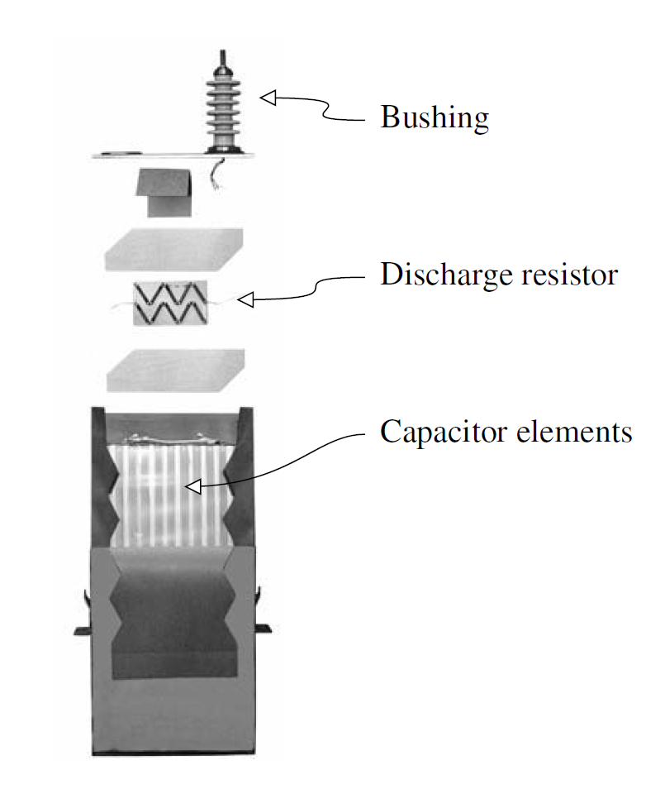
Use of Capacitors in Distribution Systems
Module #3
The components of a distribution capacitor

Slide 33
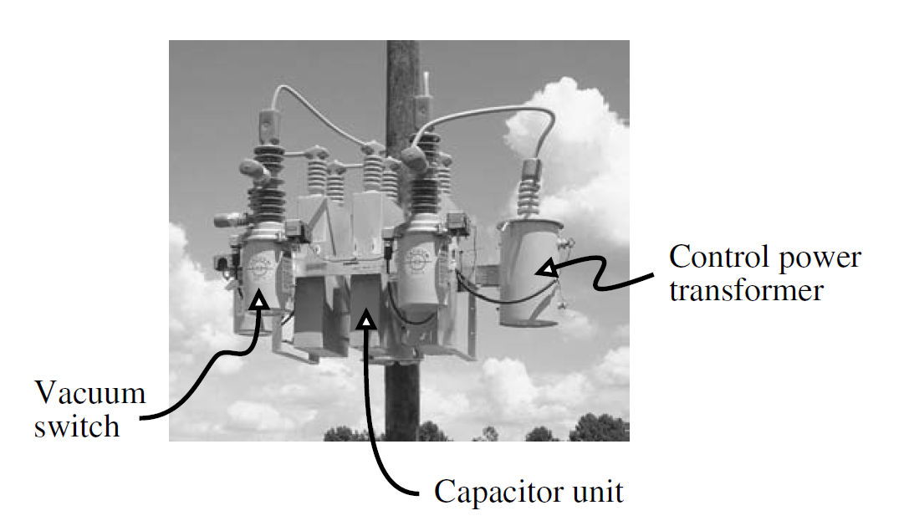
Use of Capacitors in Distribution Systems
Module #3
Pole mounted capacitor on overhead line

Slide 34
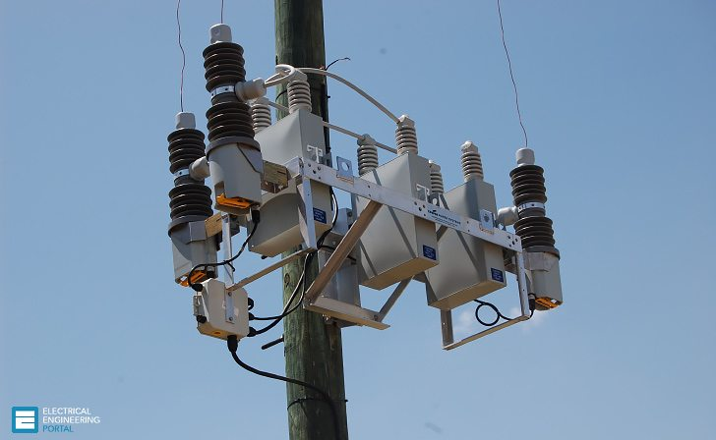
Use of Capacitors in Distribution Systems
Module #3
More overhead line capacitors

Slide 35
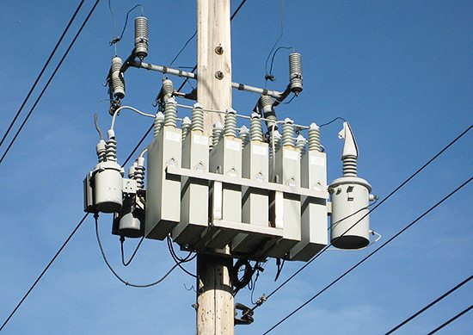
Use of Capacitors in Distribution Systems
Module #3
More overhead line capacitors

Slide 36
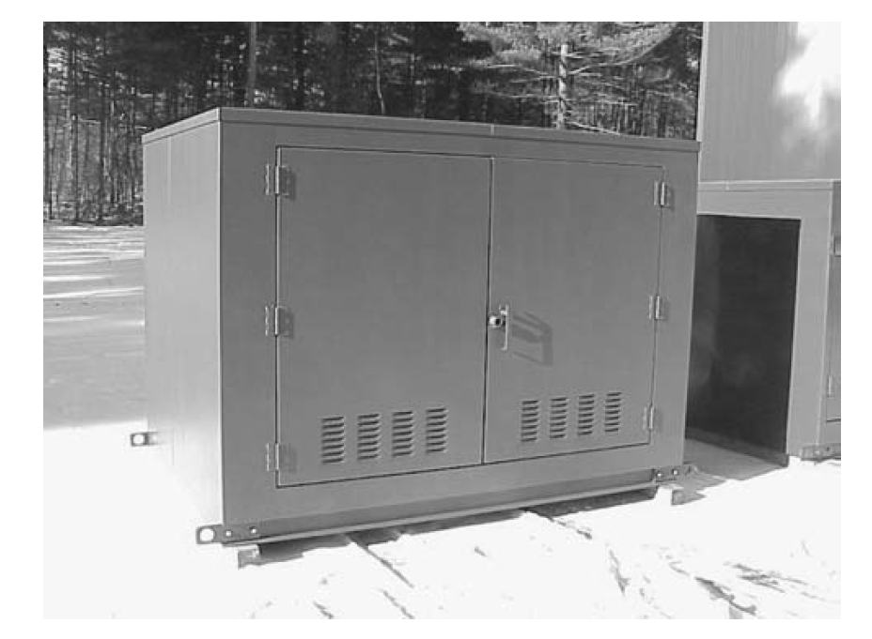
Use of Capacitors in Distribution Systems
Module #3
Pad mounted capacitor

Slide 37
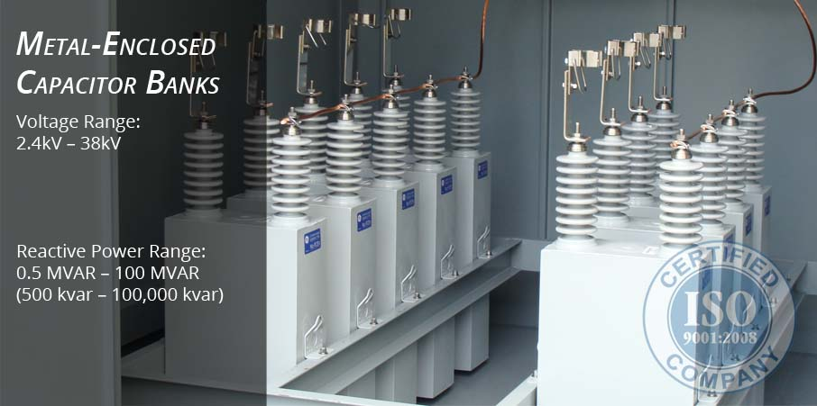
Use of Capacitors in Distribution Systems
Module #3
Capacitor banks

Slide 38
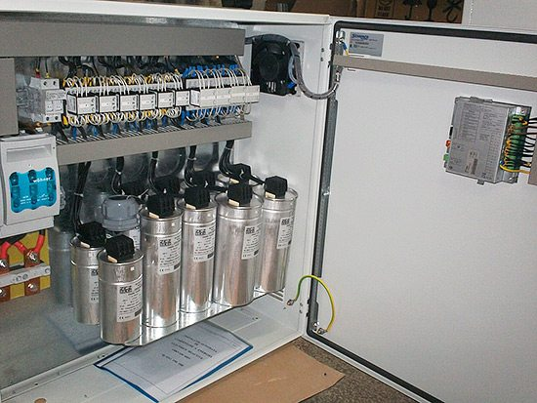
Use of Capacitors in Distribution Systems
Module #3
Capacitor banks with control circuitry

Slide 39



Use of Capacitors in Distribution Systems
Module #3
Capacitor’s can be thought of as loads which absorb negative vars, or supply positive vars. The power absorbed by a capacitor is described by
$$S_{cap}=P_{cap}+jQ_{cap}$$
where
$$P_{cap}=0$$
$$Q_{cap}<0$$

Slide 40
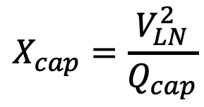
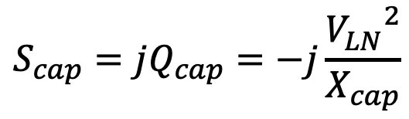
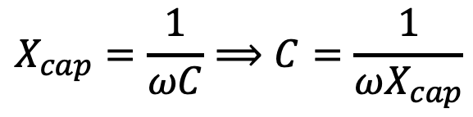
Use of Capacitors in Distribution Systems
Module #3
Therefore
$$S_{cap}=jQ_{cap}=−j\frac{{V_{LN}}^{2}}{X_{cap}}$$
which we can find the reactance of the capacitor by
$$X_{cap}=\frac{V_{LN}^{2}}{Q_{cap}}$$
and capacitance by
$$X_{cap}=\frac{1}{ωC}⟹C=\frac{1}{ωX_{cap}}$$

Slide 41
Loads in Distribution Systems
Module #4

Slide 42
Loads in Distribution Systems
Module #4
Loads in distribution systems can be quite complex to model. Load models include
Constant power (PQ) – watts and vars are constant
Constant impedance (Z) – ohms are constant
Constant current (I) - amps are constant
Combination (ZIP) – combination of any of 1-3
We will focus only on 1

Slide 43
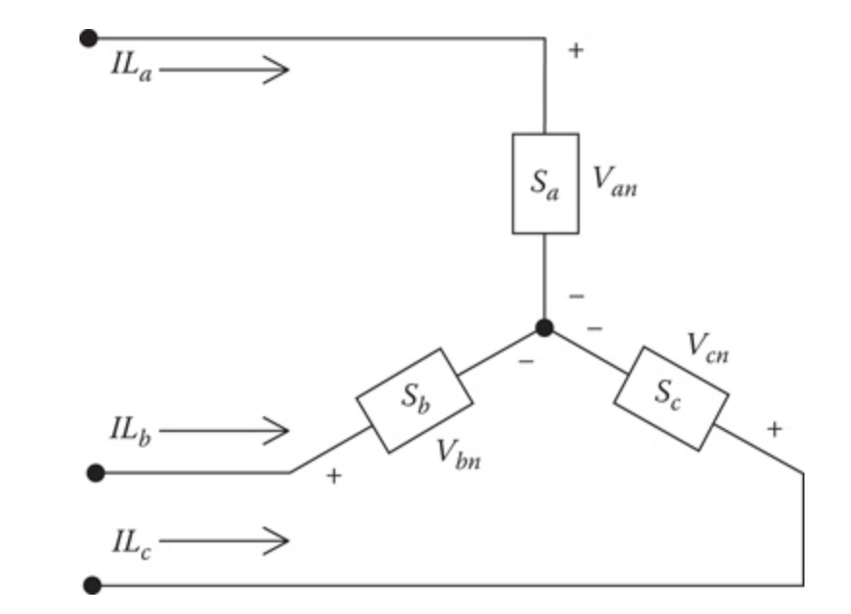
Loads in Distribution Systems
Module #4
Constant impedance loads can be
Single-phase
Two-phase
Three-phase
All can be connected in delta or wye, we will focus on wye

Slide 44
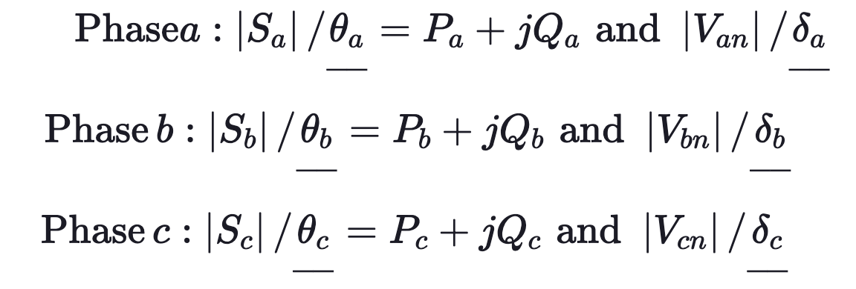
Loads in Distribution Systems
Module #4
The notation for the specified complex powers and voltages are as follows:

Slide 45
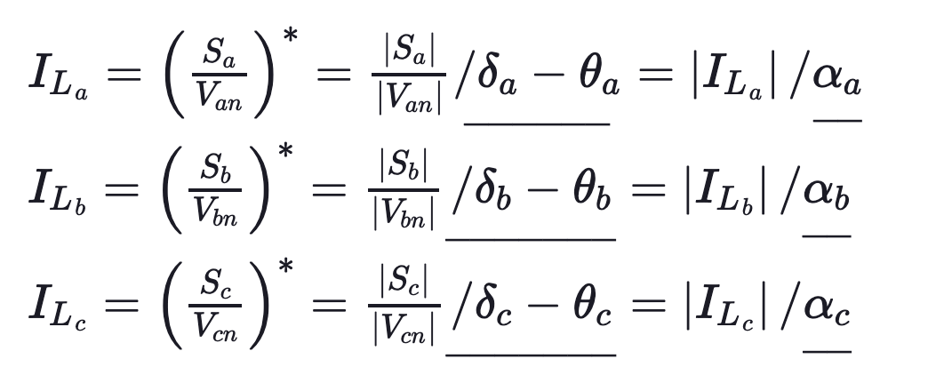
Loads in Distribution Systems
Module #4
The line currents for constant real and reactive power loads (PQ loads) are given by:
In this model, the line-to-neutral voltages will change during each iteration until convergence is achieved.

